Slide 1
Supporting ELs in the Classroom

Slide 2
ELs at Germantown
ELs – 40
Transitional- 15
***Many of our ELs do not have language/content support at home.

Slide 3
ILP vs. IEP
ELs do not have IEPs, but they do have ILPs (Individual Language Plans).
The ILPs provide personal background information including scoring. Additionally, the form lists accommodations for instruction, assignments, and assessments. Look at which boxes are checked.

Slide 4
Based on research, grades 6-12 prove to be the most challenging for ELs due to the expectations of learning social language simultaneously with academic language.

Slide 5
Research shows that while it takes 2 to 3 years to acquire basic English communication, it takes
6 to 8 years to acquire academic English proficiency.
While many English learners:
speak in sentences
communicate socially with peers
They continue to struggle with:
grade-level reading passages
academic vocabulary
comprehending textbooks

Slide 6
How do I determine who is
an English Language Learner?

Slide 7
WIDA
World-Class Instructional Design and Assessment
Consortium of 40 states
Focuses on what students “can do”
Advances academic language development for youth who are culturally and linguistically diverse
Offers high quality standards and assessments

Slide 8
WIDA SCREENER
An assessment to screen for language proficiency
Given to students who are new to the country or to the district
If there is an answer other than English on the Primary Home Language Survey, students will be given the WIDA Screener
The Screener is an online test covering 4 domains: listening, reading, speaking, and writing

Slide 9
WIDA ACCESS
Given in the Spring, usually February/March
Evaluates language growth
All students who have not exited the program take the ACCESS test
Covers the 4 domains: listening, reading, speaking, and writing
EXITING: 4.2 on the composite and 4.0 on literacy

Slide 10
SERVICES
Daily: students who score a 3.4 or below on WIDA ACCESS
Push-In: students who score 3.4 or below on WIDA ACCESS or who are monitored
Consultative: students who score 3.5 and up and even Transitional
*** Transitional: students who have exited based on WIDA ACCESS. They are monitored for 2 years after exiting.

Slide 11
ACCOMMODATIONS
. . . . . .

Slide 12
Modification vs. Accommodation
Finding ways to make the content understandable.
Modification – any change made to the curriculum that enables a student to be successful in content classrooms
Modifications DO change what the student is expected to master. Course/activity objectives are modified to meet the needs of the language learner.
Accommodation – alteration of environment, curriculum format or equipment used, extended time, read aloud, bilingual dictionary, oral responses
Accommodations do NOT change what the student is expected to master but HOW the student masters the content. The objectives of the course/activity remain intact.

Slide 13
Accommodations for Instruction
Visuals and Graphic Organizers
Modeling / Examples
Bilingual Dictionaries
Reading Aloud
Extended Time
Rewording/ Simplifying Instructions
Multiple Checks for Understanding
Partnering/ Groups

Slide 14
Accommodations for
Environment
Groups
Partners: same language or stronger student
Seating in class: closer to the front or teacher

Slide 15
Accommodations for
Formative/ Summative Assessment
Read Aloud
Extended Time
Bilingual Dictionary
Alternate Format: oral, visual, graphic organizer, chunking, changing font size, etc.

Slide 16
Make Content Accessible:
Scaffold
When giving an assessment, determine the main concept(s) you are testing and what details are nonessential for understanding the concept(s).
ELs are doing twice the work in school. Not only are they responsible for the content knowledge, but they are also simultaneously learning and acquiring English.
This is why it is imperative that we focus on assessing these students on only the most important content concepts – not the details.

Slide 17
INSTRUCTIONAL
STRATEGIES

Slide 18
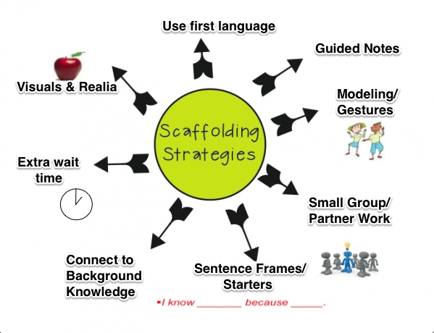

Slide 19
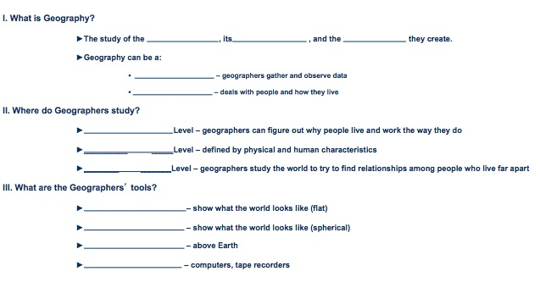
Guided Notes: cover main concepts, are made directly from the assessment, allows EL to focus on academic language

Slide 20
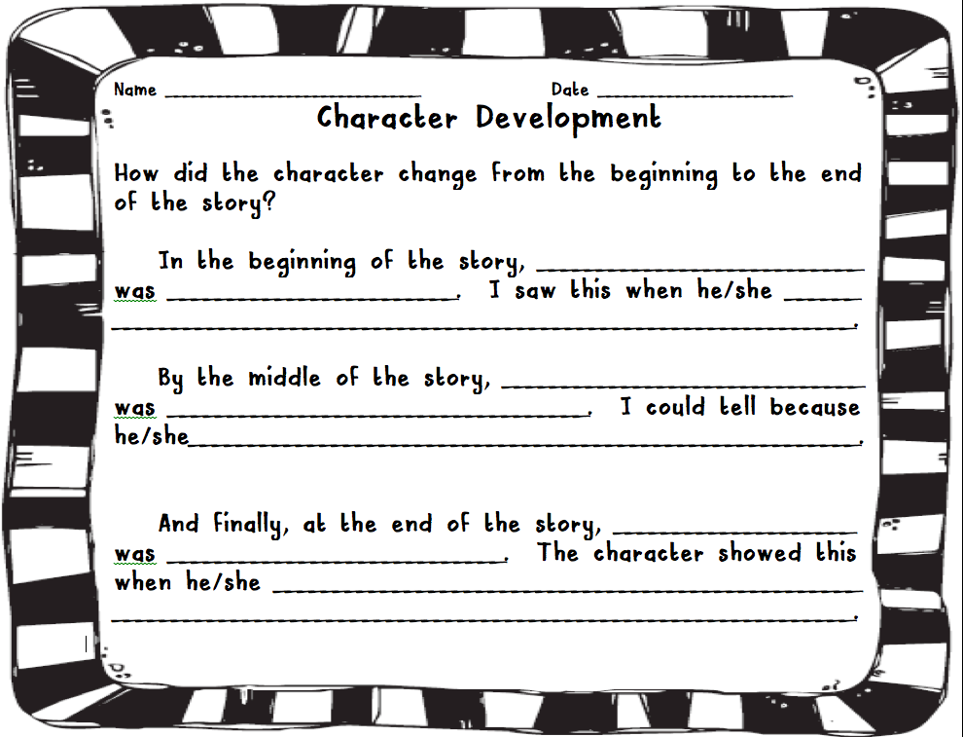
Sentence/Paragraph Frames: gets them started on writing, allows student to focus on content

Slide 21
Sentence Starters & Visuals
Compare and contrast amphibians and reptiles.
_________ and __________ both__________. However, _______is different than ________ because ____________.
What is the main idea of the article?
The article is about __________. An important detail is _________.

Slide 22
Paragraph Frame
Frame for Writing Analytical Summaries
Introduction:
In the _____________ “______________”, ______________________
(article, essay…) (title) (the author’s name)
_______________________ ________________________.
(verb: discusses, explains….) (the main idea, thesis)
Body paragraphs
______________, ________________ _______ _________. ___________________
(transition) (author’s last name) (verb) (evidence) (Your reflection)
Introducing Textual Evidence:
According to author’s name, evidence…
In the article, “Title of the article”, author’s name explains…

Slide 23
LANGUAGE
. . . . . .

Slide 24
Language that causes difficulty for EL understanding:
- Complex definitions
- Figurative language/multi- meaning words
- Conditional statements (If….)
- Complex sentences
- Advanced verb tenses
- Nonessential Information

Slide 25
How to simplify text:
Grade Level Definition
Supergiant – Late stage in the life cycle of a massive star in which the core heats up, heavy elements form by fusion, and the star expands; can eventually explode to form a supernova.
Simplified Definition
Supergiant – A star’s core heats up and the star expands.

Slide 26
How to simplify text:
Complex: Were able to accumulate vast amounts of wealth
Simplified: Were able to get large amounts of money
Simplify Discussion Questions
Before: Explain clearly using at least three different reasons or drawing three diagrams why McClelland lost the battle.
After: Explain why McClelland lost the battle. Give three reasons or draw three diagrams.

Slide 27
Multi-meaning words (polysemous) add confusion
Table – furniture vs. arrangement of numbers, symbols or words to show a relations
Mean - to offend vs. an average
or be unkind
Cell – smallest unit of
an organism vs. Small room in a prison
Cell phone
Small compartment within a larger structure (honeycomb, spreadsheet)

Slide 28
ASSESSMENTS
. . . . . . .

Slide 29
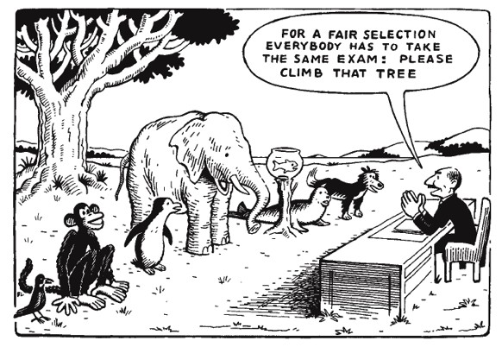
Assessments
Match the complexity of the content with ELs language ability
Plan assessment to meet the needs of the EL
It is not a crime to:
Give clues/prompt
Change questions to yes/no answers for oral/written responses
Divide word banks into chunks
Tailor the test to your students’ language level
Give alternate assessments

Slide 30
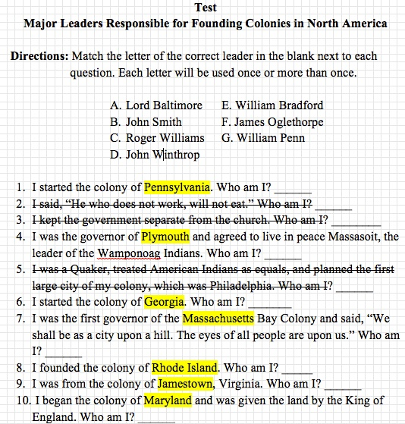
Focusing the Content on Assessments
Highlighting Key Words
Helps direct the EL to key academic terms
Makes the test more manageable
Helps EL focus on content over language
Correlate study guide to your assessments by highlighting key academic vocabulary/concepts

Slide 31
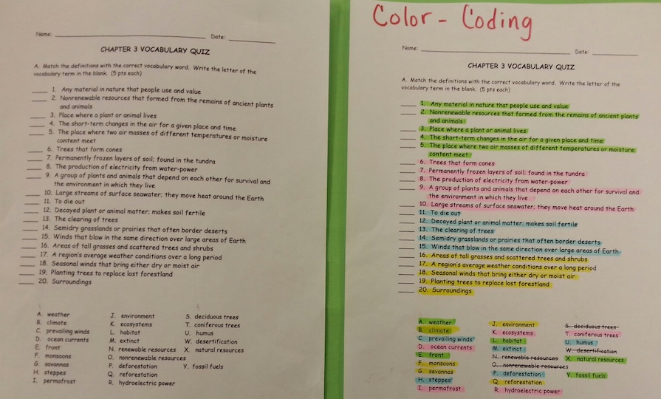
Assessments: color-coding & chunking information

Slide 32
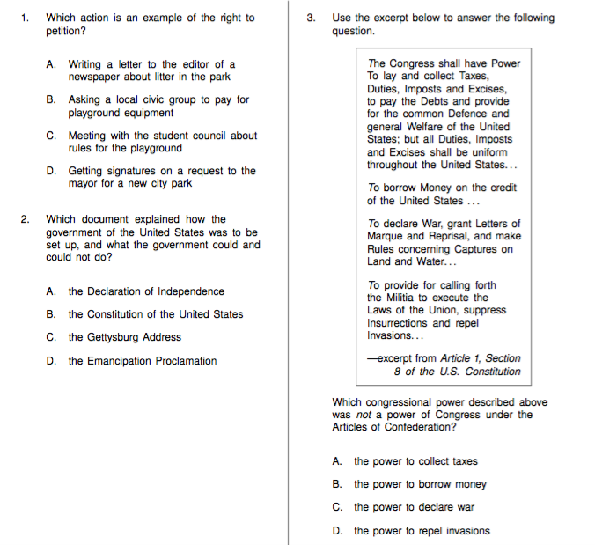
History Assessment: Before

Slide 33
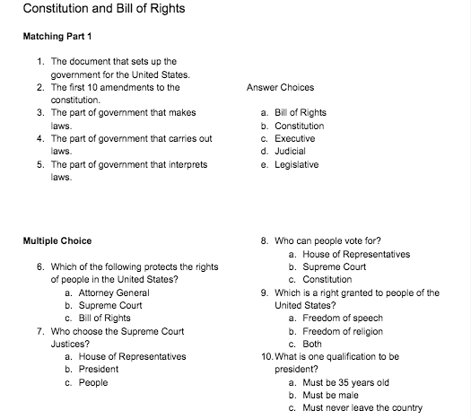
After

Slide 34
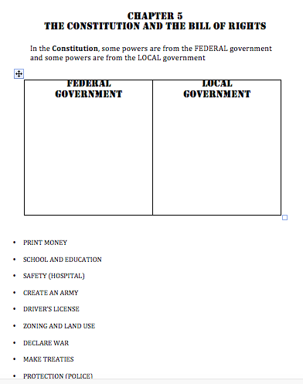
Continued

Slide 35
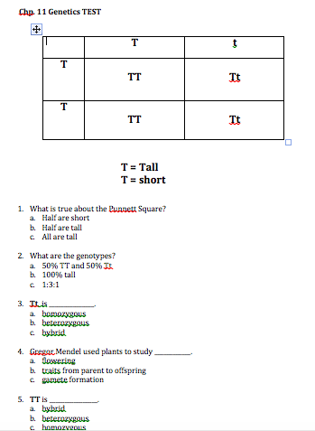
Science: Assessment is focused and simplified

Slide 36
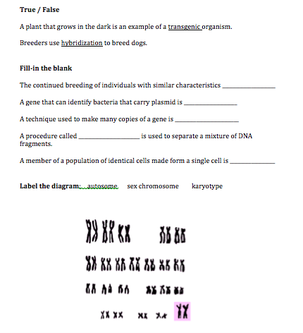
Continued

Slide 37
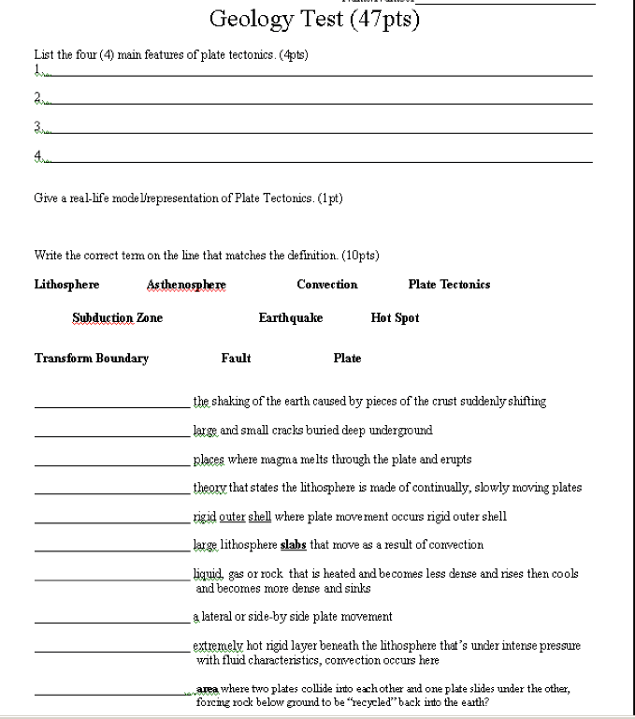
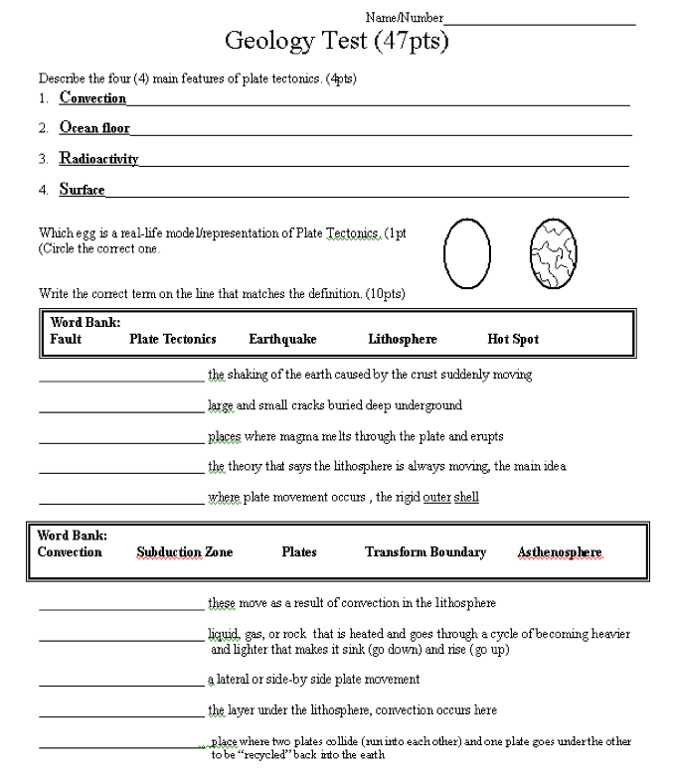
Focused Assessment
Before After

Slide 38
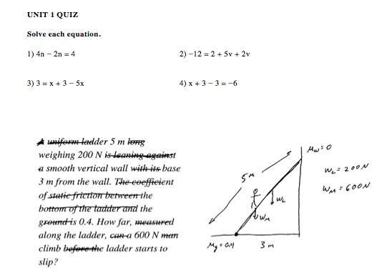
The assessment is simplified and focused.
Depending on the student, you could either draw out the figure or leave it for the student to draw.

Slide 39
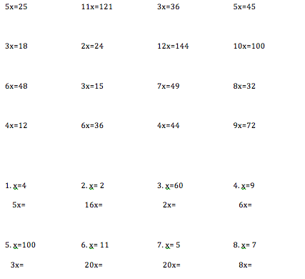
Continued: Give the student lots of opportunities to practice the foundational skills. Hand out for homework and post-assessment.

Slide 40
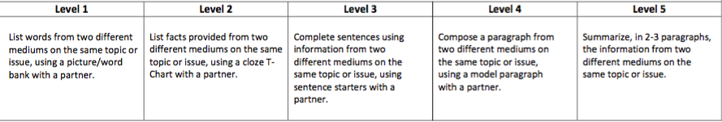
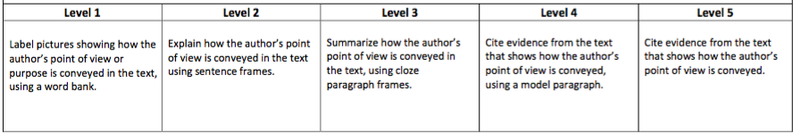
Writing: You can match a task with the student’s level.
Level 1 is Low-Beginning and Level 5 is Advanced. You could assign Intermediate and Advanced students a different task each day.

Slide 41
Sample Schedule
Monday - Bellwork: Define ACT word and write a sentence. Classwork: Using the text, identify unfamiliar words with a highlighter. Define and translate.
Tuesday - Bellwork: Correct the grammar in the following sentence. Focus on subject/verb agreement. Classwork: Make a T-chart. Using the text, list all of the examples of imagery and all of the examples of rhyme. Write two imagery and two rhyme statements.
Wednesday – Bellwork: Write a narrative in 5-8 sentences using the prompt. Use one example of alliteration. “It was a dark, rainy night when I….”. Classwork: Chunk lines 50-65 in groups of 3. Paraphrase each chunk into your own words. What is the speaker’s purpose? How does the speaker’s mood change?
Thursday – Bellwork: Using content clues, define the underlined word in your own words. Write a sentence. Classwork: Focus on paragraphs 2 and 3. Define and translate unknown words. Write a Claim, Cite, Clarify for each paragraph.
Friday – Bellwork: Correct the grammar in the following sentence. Focus on prepositions. Classwork: Write a 2 paragraph summary discussing the characteristics of the speaker. Cite evidence from the text.
ENGLISH

Slide 42
Sample Schedule
Monday – Bellwork: What does poly mean?Classwork – Following the teacher, fill-in your guided notes. Check your notes with a partner. Define and translate unknown words. Create your vocabulary list.
Tuesday – Bellwork: _______ and _______ are examples of polygons. Classwork: Identify each polygon. Mark the sides that are equal.
Wednesday – Bellwork: A quadrilateral is a polygon with ______ sides. What does quad mean? Classwork: Write the perimeter formula on your paper. Using your calculator, find the perimeter for each polygon.
Thursday- Bellwork: Draw and label each polygon from this week. Classwork: Identify each polygon, mark equal sides, and calculate the perimeter for each polygon. Review your vocab list.
Friday – Bellwork: Review vocab list and worksheets. Take assessment which includes listing and defining 5 words from your vocab list.
Math

Slide 43
Sample Schedule
Monday – Bellwork: What does homo mean? What does hetero mean? Classwork: Following the teacher, fill-in your guided notes. Check your notes with a partner. Identify, define, and translate unknown words. Create your vocabulary list.
Tuesday – Bellwork: Look at the example. Which allele is dominant? Which allele is recessive? Classwork: Work with a partner to complete each Punnett Square. Write the genotype for each.
Wednesday – Bellwork: Who is Gregor Mendel? What did he use to study genetics? Classwork: Read each short text. Determine the alleles for each parent. Draw a Punnett Square for each.
Thursday – Bellwork: Why is genetics important? List the traits you inherited from each parent. Classwork: Look at each Punnett Square and the answer choices. Circle the answer that is true for each. Review your vocabulary list and notes.
Friday – Bellwork: Which genetic trait is the most common in your family? Take assessment which includes listing and defining 5 words from your vocab list.
Science

Slide 44
Sample Schedule
Monday – Bellwork: How many religions exist in the world? Take a guess. Classwork: Create a vocabulary list with the following words: sacred, worship, follower, synagogue, mosque, BCE, CE, founder, law, tolerance. Define and translate each word.
Tuesday – Bellwork: Do you think tolerance is important? Why or why not? Classwork: Following with the teacher, fill-in your guided notes. Check your notes with a partner. Make flashcards for vocabulary list.
Wednesday – Bellwork: List the 5 religions from your guided notes. Classwork: With a partner, complete the world religions chart.
Thursday – Bellwork: Which world religion has the most followers today? Classwork: Read the short text. Make a T-chart with ‘Compare’ and ‘Contrast’. Using the text, identify the similarities and differences between the 2 religions. List them on the T-Chart. Review your vocabulary list.
Friday – Bellwork: List one fact from each religion this week. Quiz on vocabulary. Complete world religions study guide with a partner.
History

Slide 45
Sample Schedule
Monday – Bellwork: Define the word portrait. Classwork: Using Play-Doh, create a face. Respond to the question: What shapes did you use to create the face?
Tuesday – Bellwork: Define the word contour. Classwork: Read the short text on Chuck Close. Respond to the questions: What was the subject of Close’s work? What method did he use? What painting techniques did he use? Photorealist painting is also called ________.
Wednesday – Bellwork: Look at the two portraits. How are the lines different? What similar shapes do both portraits use? Classwork: Create a grid using your copy. Begin working, copying cell by cell.
Thursday – Bellwork: Define scale and proportion. Classwork: Continue working on grid drawing. Review vocab words from the week.
Friday – Bellwork: List two ways the grid helps you with your portrait. Quiz on vocabulary words. Continue working on grid drawing.
Art

Slide 46
Current EL Facts provided by conexión américas
56,528 children enrolled in TN schools are English Learners.
3X
Tennessee’s foreign-born population is growing at a rate three times faster than the rest of the country.
322,200
About 322,200 Tennesseans are foreign-born. 46.5% are from Latin America, 30.1% are from Asia, 10.5% are from Europe, and 9.8% are from Africa.
65% of K-12 English Learner students were born in the United States.
TOP 6
EL Enrollment by County
Davidson
Shelby
Knox
Rutherford
Hamilton
Hamblen

Slide 47
Presentation by
Samantha Sporer
. . . . . . . .

